Slide 1
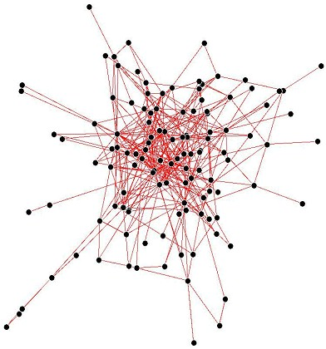

Notes:
Note Page by Willem van der Plaat

Slide 2
Tracking Changes
User A
D1
User B
D1
D1
D1.1
D1.2
D1.3
Time

Slide 3
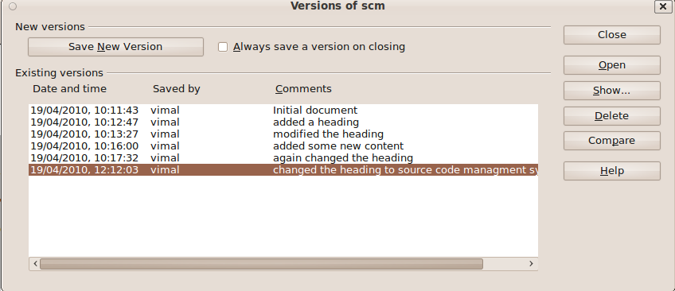
Tracking changes in a document with OpenOffice Writer

Slide 4
What about developing a software project?
Project Website
Developer A
S/w

Slide 5
what about developing a software project?
Project Website
Developer A
S/w
User A
User D

Slide 6
How about developing a software project?
Project Website
Developer A
BUG
S/w
User D
User A

Slide 7
what about developing a software project?
Project Website
Developer A
BUG
S/w
User D
User A
Fixed Code
(patch)

Slide 8
what about developing a software project?
Project Website
Developer A
apply
S/w 1.1
Fixed Code
(patch)
User D
User A

Slide 9



Softwares for Version Control
Source Code Control System (SCCS)
CVS
Subversion (svn)
Mercurial
Bazaar
Git
Etc...

Slide 10
Git
Developers : Junio Hamano and Linus Torvalds and several other people
Website : http://git-scm.com/
Linus Torvalds started its development on April 2005
Distributed Version Control System

Slide 11
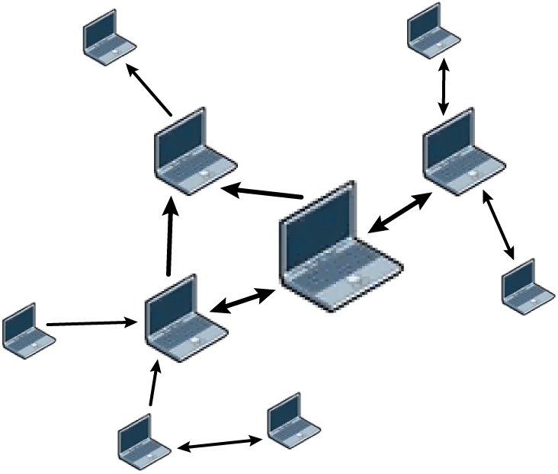
Distributed Version Control System

Slide 12
Let's Start the Git
Introduce yourself to git
  git config –global user.name “Vimal Joseph”
  git config –global user.email “vimaljoseph@gmail.com”
Add some colour
  git config –global color.ui true
Now your global configuration file is ready. You can check that at ~/.gitconfig

Slide 13
Git Repository
Create a git repository
  mkdir your-directory-name\
  git init
Add initial files to the git repository
  git add file1 file2
Commit changes
  git commit
  (it will ask you to enter a comment)
Log and status
  git log
  git status
Help
  git help

Slide 14
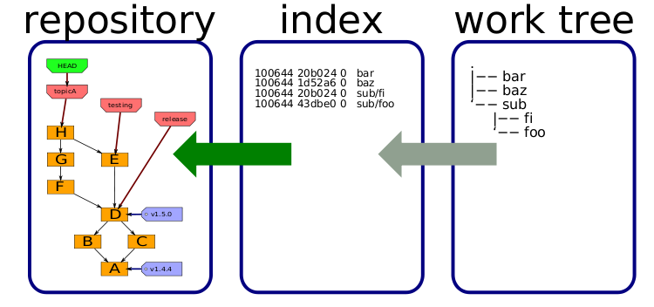
Structure of Git

Slide 15
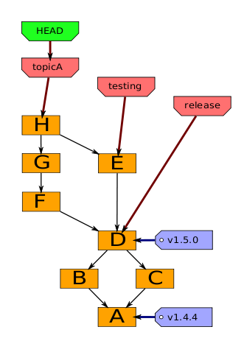
Head, Branches, Tags

Slide 16
Branching, Merging and tagging
Create new branch and switch to it
  git branch name-of-branch
  git checkout name-of-branch
Merge branches
  git merge name-of-branch-to-merge-with-current-branch
  Merge conflicts should be resolved manually
Tagging
  git tag tag-name
  It will create a tag in the current git object pointed by the HEAD

Slide 17
Working with remote repositaries
Add a remote repository
  git remote add origin url-of-remote-repository
Push Pull
  git pull
  Pull the remote branch to the local branch
  git push origin master
  Push the change to the remote branch

Slide 18
Patching
Branch
  git checkout -b fix_the_bug
Create a patch
  git format-patch master --stdout > fix_the_bug.patch
Applying the patch
  git apply --stat fix_empty_poster.patch
  git apply --check fix_empty_poster.patch

Slide 19
Working with remote repositaries
Add a remote repository
  git remote add origin url-of-remote-repository
Push Pull
  git pull
  Pull the remote branch to the local branch
  git push origin master
  Push the change to the remote branch

Slide 20

On-line git hosting
http://gitorious.org/
http://github.com

Slide 21
Thanks...
http://git-scm.com/documentation
questions??
vimaljoseph@gmail.com
http://c11.space-kerala.org/~vimal

